Slide 1
Airpower Through WW I
Notes:
1

Slide 2
Overview
Defining Airpower
Airmindedness
Doctrine
Principles of War
Tenets of Airpower
Application of Airpower
Lighter-than-air Vehicles
Heavier-than-air Vehicles

Slide 3
Overview
Early Uses of Airpower
Airpower in WWI
The Battle for Air Supremacy
US Participation in WWI
Close Air Support and Interdiction in WWI
Development of Tactics in WWI
Strategic Bombing Theorists
Evolution of Airpower

Slide 4
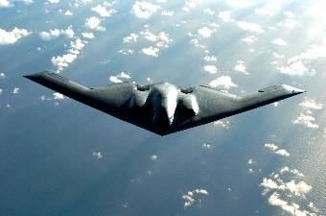
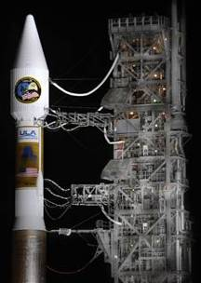
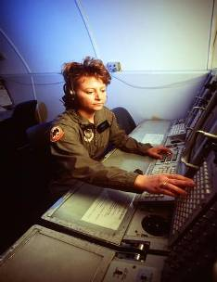
What is Airpower?
“Airpower is the ability to project military power or influence through the control and exploitation of air, space, and cyberspace to achieve strategic, operational, or tactical objectives.” ~ AFDD 1

Slide 5
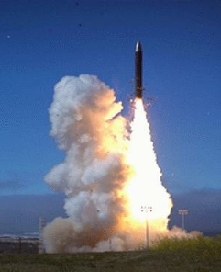

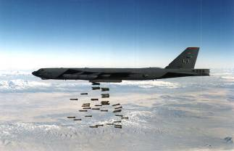
Airpower
Interdependent Dimensions
  Air
  Space
  Cyberspace

Slide 6
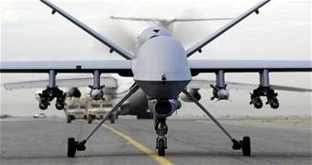
Airmindedness
Unique Perspective of Airmen
  Not merely abstract term to capture how Airmen feel; rather, it is an active cognitive process that leads to proper application of airpower
  Enables Airmen to think/act at tactical, operational, and strategic levels of war

Slide 7
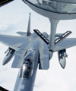
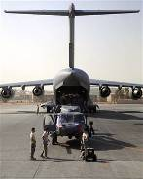
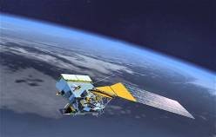
Doctrine
Definition: Fundamental principles by which the military forces or elements thereof guide their actions in support of national objectives. It is authoritative but requires judgment in application.
~ Joint Publication 1-02

Slide 8
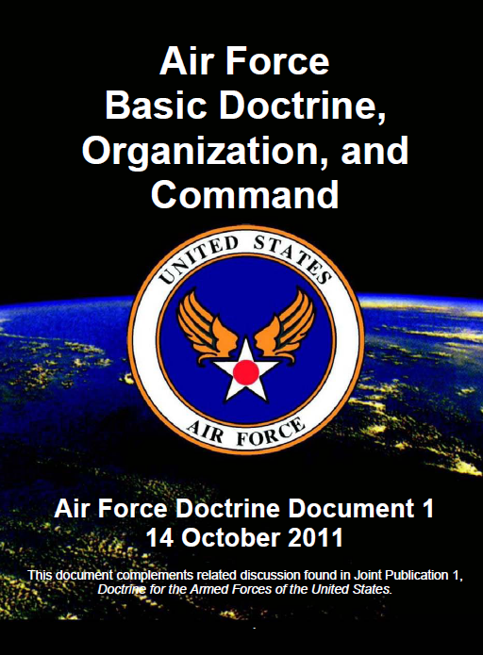
Doctrine
Air Force Doctrine
  Describes and guides the proper use of airpower in military operations.
  What we have come to understand, based on our experience to date
  Prepares us for future uncertainties
  Provides common set of understandings on which Airmen base their decisions.

Slide 9
Differentiating Policy,
Strategy, and Doctrine
Policy: Guidance that is directive or instructive, stating what is to be accomplished. It reflects a conscious choice to pursue certain avenues and not others.
Strategy: Defines how operations should be conducted to accomplish national policy objectives.
Doctrine: Presents considerations on how to accomplish military goals and objectives.

Slide 10
Applying Doctrine
War fighting, not physics
Effects, not platforms
Using mediums, not owning mediums
Organization, not organizations
Synergy, not segregation
Integration, not just synchronization
The right force, not just equal shares of the force

Slide 11
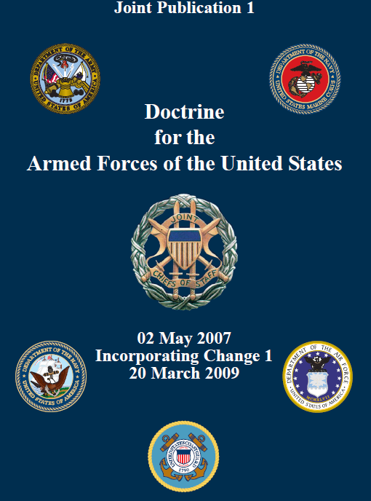
Principles of War
“…those aspects of warfare that are universally true and relevant.”
~ Joint Publication 1

Slide 12
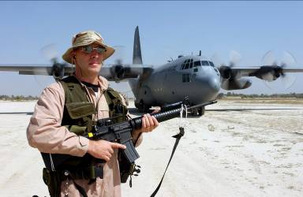
Principles of War
Historically tested
Apply equally to all US Armed Forces
Unity of Command, Objective, Offense, Mass, Maneuver, Economy of Force, Security, Surprise, Simplicity

Slide 13
Principles of War
Unity of Command: All efforts should be directed and coordinated toward a common objective
Objective: Directing military operations toward a defined and attainable objective that contributes to strategic, operational, and tactical aims
Offensive: To act rather than react and to dictate time, place, purpose, scope, intensity, and pace of operations

Slide 14
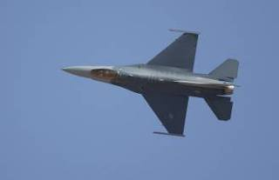
Principles of War
Mass: The purpose of mass is to concentrate the effects of combat power at the most advantageous place and time to achieve decisive results
Maneuver: Places the enemy in a position of disadvantage through the flexible application of combat power in a multidimensional combat space

Slide 15
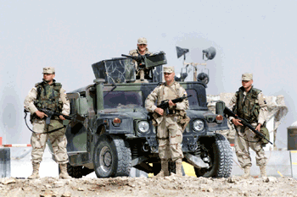
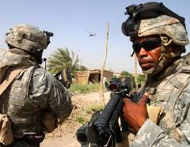
Principles of War
Economy of Force: Calls for the rational use of force by selecting the best mix of air, space, and cyberspace capabilities
Security: The purpose of security is to never permit the enemy to acquire unexpected advantage

Slide 16
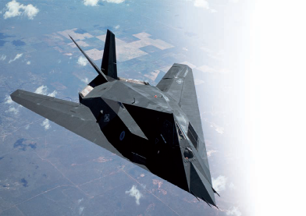
Principles of War
Surprise: Leverages the security principle by attacking the enemy at a time, place, or in a manner for which they are not prepared
Simplicity: Calls for avoiding unnecessary complexity in organizing, preparing, planning, and conducting military operations

Slide 17
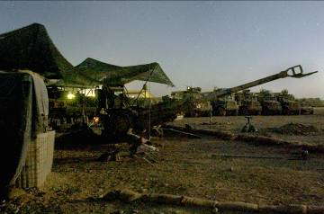
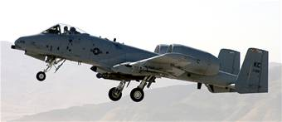
Principles of Operation
These, in combo with Principles of War, create Principles of Joint Ops
  Unity of Effort
  Restraint
Perseverance
Legitimacy

Slide 18
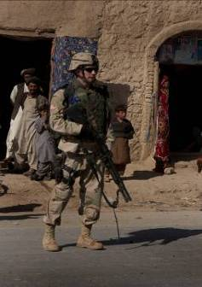
Tenets of Airpower
Fundamental truths that are unique to the air and space environment.
  Centralized Control and Decentralized Execution
  Flexibility/Versatility
  Synergistic Effects
  Persistence
  Concentration
  Priority
  Balance

Slide 19
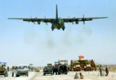
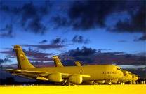
Tenets of Airpower
Centralized Control/Decentralized Execution
  Airpower must be controlled by JFACC
  Delegation of execution authority
Flexibility and Versatility
  Flexibility allows airpower to quickly and decisively shift between campaign objectives
  Versatility is using airpower effectively at all levels of warfare and with other joint force elements

Slide 20
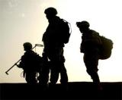
Tenets of Airpower
Synergistic Effects
  proper application of a coordinated force across multiple domains
  Persistence
  Conducting airpower operations continuously against a broad spectrum of targets
  Concentration
  Putting overwhelming power at the decisive time and place.

Slide 21
Tenets of Airpower
Priority
  Limited resources require that airpower be applied where it can make the greatest contribution to the most critical requirements
Balance
  Balancing principles of war and the tenets of airpower to bring Air Force capabilities together to produce a synergistic effect.

Slide 22
Application of Airpower
Differentiating Terms
  Roles: Broad and enduring purposes for which the Services were established by law
  Missions: Tasks assigned by the President or Secretary of Defense (SecDef) to combatant commanders
  Functions: Specific responsibilities that enable the Services to fulfill their legally established roles

Slide 23
Application of Airpower
Core Functions
Nuclear Deterrence Operations
Air Superiority
Space Superiority
Cyberspace Superiority
Command and Control
Global Integrated Intelligence, Surveillance, and Reconnaissance
Global Precision Attack
Special Operations
Rapid Global Mobility
Personnel Recovery
Agile Combat Support
Building Partnerships

Slide 24
Early Years of Flight
Man first flew aloft in a balloon in 1783
Airpower did not have an immediate impact
Flying machines were not readily accepted by land oriented officers
Airpower’s first major impact was not until World War I

Slide 25
Balloons
Montgolfier Brothers flew first hot-air balloon in 1783
Ben Franklin saw first balloon flight and immediately he saw military potential
First used for military purposes by the French in 1794 at Maubege.
Union and Confederate forces employed balloons during the American Civil War

Slide 26
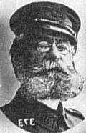
Balloons
Adolphus W. Greely, the grandfather of military aviation in the United States; revived interest in military capability of balloons in 1891
  1898: Greely balloon used to direct artillery fire during the Battle of San Juan Hill
Interest in balloons dropped quickly with the development of heavier- than-air vehicles

Slide 27
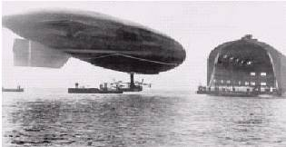
Dirigibles
Steerable balloons, often called “Airships”
1884: first successful flight in a dirigible
Ferdinand Von Zeppelin—person most readily identified with dirigibles
  Zeppelins first flown in 1900
  German dirigibles bombed England in WW I
  German dirigibles flew surface fleet observation in WW I
Vulnerable to winds and ground fire

Slide 28
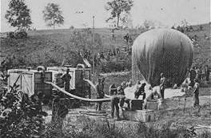
Uses of Balloons and Dirigibles
Reconnaissance
Artillery spotting
Bombing (extremely limited prior to WWI)
Morale Booster/Escape Means
Air transport of supplies

Slide 29
Early Pioneers of Flight
Otto Lilienthal—Studied gliders and first to explain the superiority of curved surfaces
Percy Pilcher—Built airplane chassis
Octave Chanute—Developed a double winged-glider/wrote history of flight to1900
Samuel P. Langley—First to secure government support to develop an airplane
  Failed twice to fly from houseboat in 1903
  Congress withdrew monetary support

Slide 30
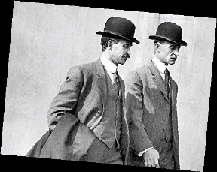
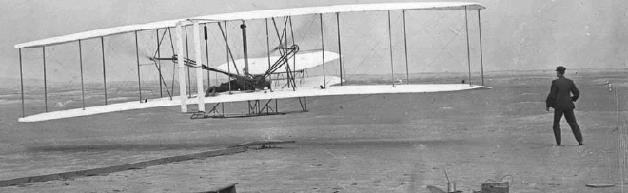
Orville & Wilbur Wright
First to fly a heavier-than-air, power-driven machine—17 December 1903
  Flight traveled 120 feet and lasted 12 seconds
Approached flying scientifically and systematically
Used experience of Lilienthal, Pilcher, and Chanute
Built a glider in Dayton in 1899
  Moved to Kitty Hawk, N. Carolina in 1900

Slide 31

Wright Brothers Video

Slide 32
Reaction to the Airplane
US government was very skeptical at first
  Not interested because of Langley’s failures
Britain and France were very enthusiastic
President Roosevelt directed the Secretary of War, W. H. Taft, to investigate the Wright brothers’ invention in 1906
Dec.1907—Chief Signal Officer, BG James Allen, issued Specification #486 calling for bids to build the first military aircraft

Slide 33
Signal Corp Spec. #486
Established the requirements for the first military aircraft. Aircraft must be able to:
  Carry two persons
  Reach speed of 40 mph
  Carry sufficient fuel for 125 mile nonstop flight
  Be controllable in flight in any direction
  Fly at least 1 hour
  Land at take-off point, without damage
  Be taken apart and reassembled in 1 hour
  No military operational requirements specified

Slide 34
Signal Corp Spec. #486
41 proposals were received, only 3 complied with specifications
US Army signed contract with Wright brothers on 10 Feb 1908
Wright brothers delivered first military aircraft on 20 Aug 1908
US Army accepted the first operational aircraft on 2 Aug 1909

Slide 35
Early Uses of Airpower
Until WWI balloons, dirigibles, and aircraft were primarily reconnaissance vehicles
Early on, the flying machines were not seen as weapons of war
Few believed the flying force was ready to be separate air force
The potential uses of aircraft would evolve considerably during WWI

Slide 36
World War I—Missions
Reconnaissance – Collecting visual and photographic information
Counterair – Air-to-air combat
Close Air Support – Support of ground forces
Interdiction – Striking enemy resources close to the battlefield
Strategic Bombing – Strikes deep into enemy territory to destroy war making capabilities

Slide 37
World War I—Missions
Reconnaissance and artillery spotting
  Took away the element of surprise
  Hampered by weather / unserviceable aircraft
Pursuit Aviation (Air superiority)
  Grew out of attempts to deny reconnaissance
  1st air-to-air kill occurred in Oct. 1914
  Developed rapidly in WWI
  Key to winning the air war

Slide 38
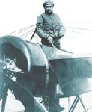
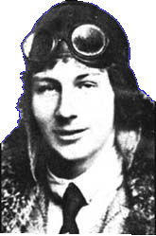
Technological Developments
Roland Garros (French): Developed metal strips for propellers so machine gun bullets would not shatter the props
Anthony Fokker (Dutch): Designed synchronizing gear so bullets would pass through the spinning propeller blades

Slide 39
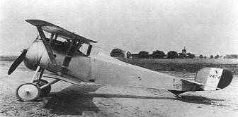
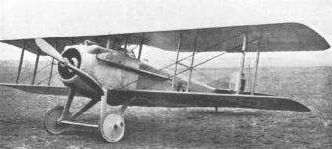
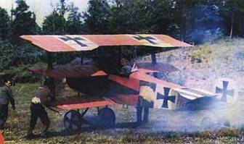
Technological Developments
Nieuports and Spads (French): Most reliable and flexible aircraft in 1916
Fokker Triplanes: German aircraft that put the Germans back on top in 1917

Slide 40

Rickenbacker Video

Slide 41
US Participation in WWI
When United States entered the war in April 1917, US Air Service was totally unprepared
  Aviation Section had 56 pilots and less than 250 airplanes; none ready for combat
Congress approved $640 million in July 1917 to raise 354 combat squadrons
At the end of WWI, Air Service had 183,000 personnel and 185 squadrons

Slide 42

Mitchell Video

Slide 43
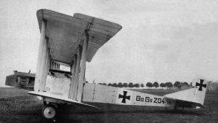
Strategic Bombing in WWI
Limited in scope and intensity
Had a negligible outcome on the war
Laid the foundation for future thought

Slide 44
Bombing of Britain
1915-16: Germans conducted daylight bombing raids against Britain w/ Zeppelins
  Stopped because of poor results
1917: Germans reinitiated daylight raids w/ Gotha bombers—ineffective
1917-18: Germans begin night bombing w/ Zeppelins and Reisen bombers
  Primarily terror raids
  Strengthened British morale; destroyed little war making capacity

Slide 45
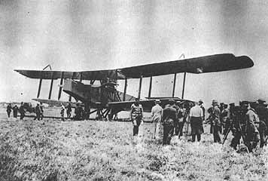
Allied Bombing of Germany
Began in 1914; generally ineffective
British bombed German cities and airfields in retaliation for German strikes
Allies created the Inter-Allied Independent Air Force (IAIAF) in 1919 for the purpose of bombing Germany.
  War ended before the IAIAF was used
British Handley Page Bomber

Slide 46
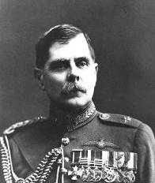
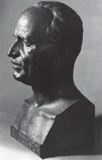
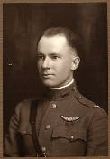
Strategic Bombing Theorists
Sir Hugh Trenchard
Giulio Douhet
Lt Col Edgar Gorrell

Slide 47
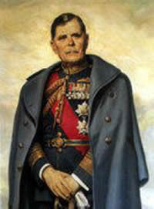
Sir Hugh Trenchard
Commander of the Royal Air Force
Primary target should be civilian morale
Believed allies should attack German homeland
Attack around the clock

Slide 48
Giulio Douhet
General in the Italian Army
Believed airpower was supreme after WWI
Believed bombers would win all wars
Air weapon would be used against ports, railroads and economic structures
Best way to gain air superiority was to destroy the enemy’s ground organization

Slide 49
Giulio Douhet
Once air superiority was achieved, bombers would concentrate on cities to destroy industry and morale
Influenced by Italian geography where there was little threat of a ground invasion
His doctrine led to a Total War Concept—war on the nation as a whole, not just military forces

Slide 50
Lt Col Edgar S. Gorrell
Theories mirrored Trenchard, but felt bombing should concentrate on one city at a time until destroyed
Ignored during war, ideas recognized in 1930s
Believed best way to stop Germans was to destroy production
Stressed continuous day/night bombings to deprive Germans of rest and repair time
Proposed attacks of single to target to complete destruction

Slide 51
Evolution of Airpower
So, what have we learned?
  What were significant airpower achievements and changes during this period?
  What was the impact of these achievements and changes?

Slide 52
Summary
Defining Airpower
Airmindedness
Doctrine
Principles of War
Tenets of Airpower
Application of Airpower
Lighter-than-air Vehicles
Heavier-than-air Vehicles

Slide 53
Summary
Early Uses of Airpower
Airpower in WWI
The Battle for Air Supremacy
US Participation in WWI
Close Air Support and Interdiction in WWI
Development of Tactics in WWI
Strategic Bombing Theorists
Evolution of Airpower

