Slide 1
Airpower Through the Cold War

Slide 2
Overview
National Security Act of 1947
Berlin Airlift
Curtis LeMay
Korean Conflict
Cuban Missile Crisis

Slide 3
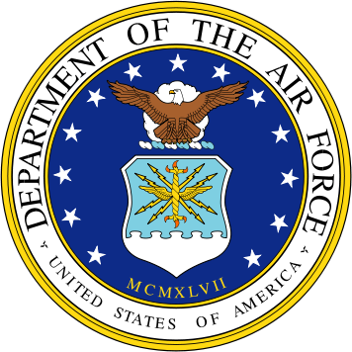
National Security Act of 1947
Established the Department of Defense and created the Air Force
Executive Order 9877 outlined the main functions of the Air Force
The United States Air Force stood up on 18 September 1947

Slide 4
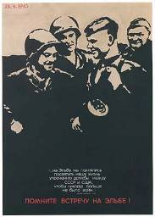
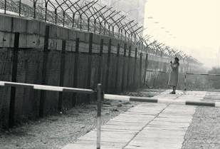
Circumstances after WWII
Soviets intent on security of their borders
Russia had been invaded twice
Soviets suffered millions of casualties in the WWII invasion
Allies were not seeking vengeance in Germany
Allies wanted to revitalize and stabilize economy

Slide 5
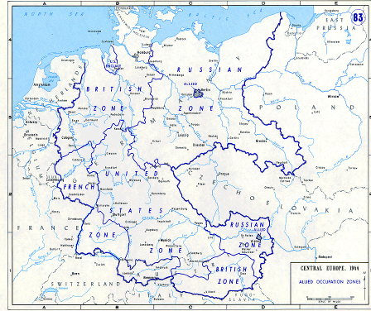
Allied Occupation Zones
Soviets given East Germany to include Berlin
United States given southwest Germany
Britain given northwest Germany
Berlin then divided, and Allies, including France, each given a sector inside Berlin itself

Slide 6
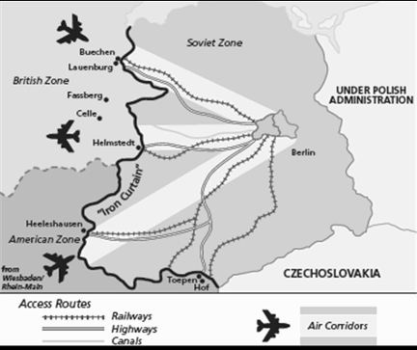
Blockade
Soviets refused to supply food
Soviets allowed three air corridors
Soviets demanded their currency (money) be adopted
Soviets blockaded road, rail, and waterways
Soviets cut off all power

Slide 7
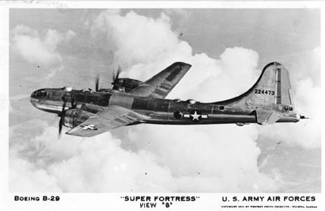
Allied Response (United States)
Airlift mission begins
Backup of airlift through basing of strategic nuclear capability in England (36 B-29s deployed)

Slide 8
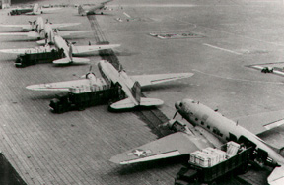
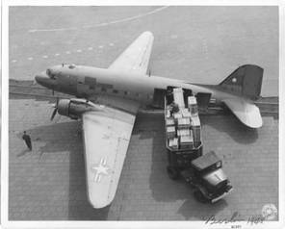
Airlift Begins
25 June 1948
C-47 (Skytrain) could fly 2 to 3 tons of cargo
C-54 (Skymaster) could fly 10 tons of cargo
2 million tons of cargo in almost 277,000 flights
C-54
C-47

Slide 9
Tunner Video 2

Slide 10
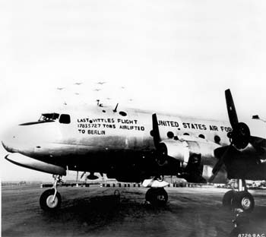
Results
Diplomatic weapon
Technological achievement
Strength of airpower

Slide 11
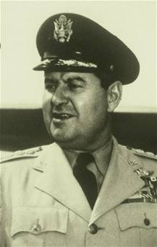
General Curtis LeMay
“I don’t mind being called tough, since I find in this racket it’s the tough guys who lead the survivors.”
~ Colonel Curtis E. LeMay, to Lt Gen Ira Eaker England, 1943

Slide 12
LeMay Video 2

Slide 13
General Curtis LeMay
Navigator on B-17 as lieutenant in early airpower demonstration with ocean liner “Rex” in 1938
Commanded units in Berlin airlift
Commander in Chief, Strategic Air Command (CINCSAC)
Air Force Chief of Staff
Notes:
4
4
4

Slide 14
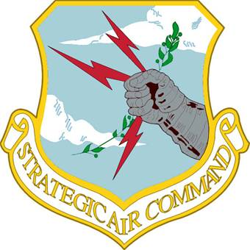
LeMay’s Impact on the Air Force
More realistic training programs
Bottom line—discipline
Procured personnel and aircraft
Bombers became airborne nuclear alert
Nuclear deterrence became a reality

Slide 15
Korea Intro Video

Slide 16
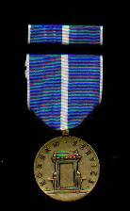
Korean Conflict
National Security Council (NSC) directive 68 called for a massive increase in defense spending to contain Communism (April 1950)
Korea was the first test of American resolve
Korean War Service Medal

Slide 17
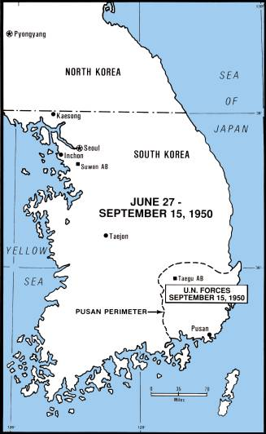
Beginning of Korean Conflict
June 25, 1950, North Korea launched a surprise invasion of South Korea
Congress approved use of force to repel North Korean invasion (no formal declaration of war)
UN Security Council authorized aid (Gen Douglas McArthur named Commander)

Slide 18
Tunner Video 3

Slide 19
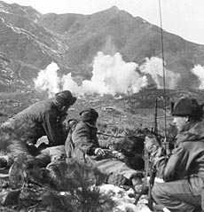
Korean Conflict
UN forces were saved at the Pusan perimeter by around the clock bombing and interdiction
McArthur launched surprise amphibious assault at Inchon
UN forces drove North Koreans back across 38th parallel and attempted to unify the country
China entered, pushing the UN forces back

Slide 20
Airpower in Korea Video

Slide 21
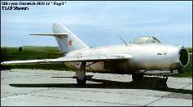
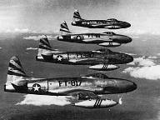
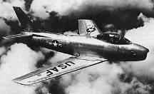
Airpower in Korean Conflict
First use of jet fighters on both sides
MiG-15 outperformed F-80
MiG-15 retreated back to bases in China
Airspace south of Yalu river known as “MiG Alley”
F-86 Sabre proved superior to the MiG-15—Kill ratio of 10-to-1
MIG-15
F-80
F-86

Slide 22
Airpower in Korean Conflict
Contributions of airpower to the Korean conflict
Counterland: Airpower operations conducted to attain and maintain a desired degree of superiority over surface operations by the destruction or neutralization of enemy surface forces
Interdiction: Operations to divert, disrupt, delay, or destroy the enemy’s surface military potential before it could be used effectively against friendly forces
Close Air Support: Operations against hostile targets in proximity to friendly forces

Slide 23
Schriever Video

Slide 24
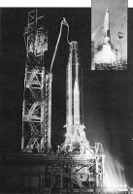
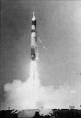
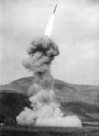
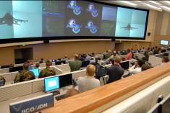
Deterrence and Missile Development
SNARK
Atlas, Titan
Minuteman became the mainstay of SAC’s missile retaliatory force
NORAD established in 1957
Single Integrated Operational Plan for using nuclear weapons (SIOP)

Slide 25
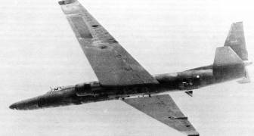
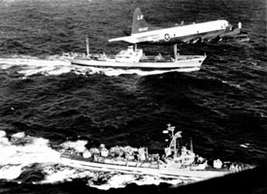
Cuban Missile Crisis
Sept 1962—U-2 reconnaissance plane detailed Soviet missile launchers in Cuba
US missile force placed on alert status
President Kennedy chose option of naval quarantine
Soviet Union backed down and the nuclear crisis was averted
Doctrine of “Flexible Response” evolves

Slide 26
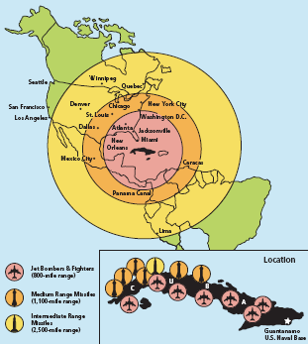
Summary
National Security Act of 1947
Berlin Airlift
Gen Curtis Lemay
Korean Conflict
Cuban Missile Crisis

